Slide 1
Big Mountain Resort
Data Science Method to Increase Revenue

Slide 2
Problem - Solution
Problem
Recommendations
A new chair lift is installed.
The operational cost surged by $1,540,00.
We seek to recoup these costs in the upcoming season by increasing revenue.
Summit elevation and Snowfall contribute to better Skiing Terrains.
Night Skiing should be started for extending our customer base.
Open the resort for more days in the upcoming season to increase revenue.
Update our ticket price to the optimal price of $55, predicted by the regression model.

Slide 3
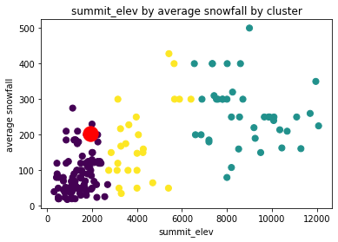
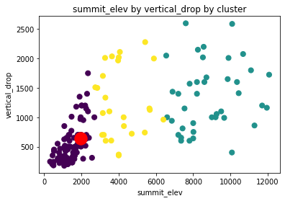
Analysis Plots
Average Snowfall
Summit Elevation

Slide 4
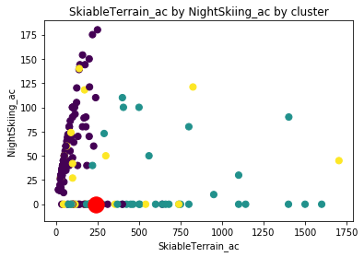
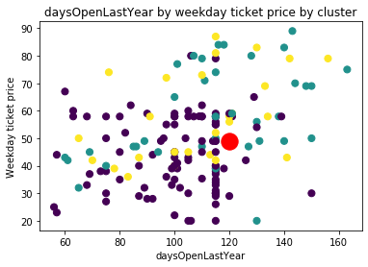
Analysis Plots
Night Skiing
Summit Elevation

Slide 5
Summary
Given the features, ticket price of the Big Mountain Resort is less than the predicted optimal ticket price.
Manipulating snowfall and heights seem unreasonable, but data proves their heavy significance.
Night Skiing is a relatively new feature provided by very limited resorts so far. However, it can generate extra revenue and attract new customers for the resort.
The resort can function longer and open more days in the upcoming season to increase its revenue.

